Slide 1

Ranked
Choice
Voting
A Better way to Vote …… understanding
Barbara Klein, LWV Rogue Valley
Action Chair
January 2020
Notes:
Leave slide – (or darken) to Run Paula’s Assistant election

Slide 2
Determining an Election Winner
Plurality – who ever gets the most votes wins
Majority – 50% + 1 vote (shortcut)
NOT THE SAME
Notes:
That ‘majority’ is actually based on a mathematical formula

Slide 3

Scary Math
Notes:
Anyone figure out the formula on the board already?
Show BEER poster………..review it

Slide 4
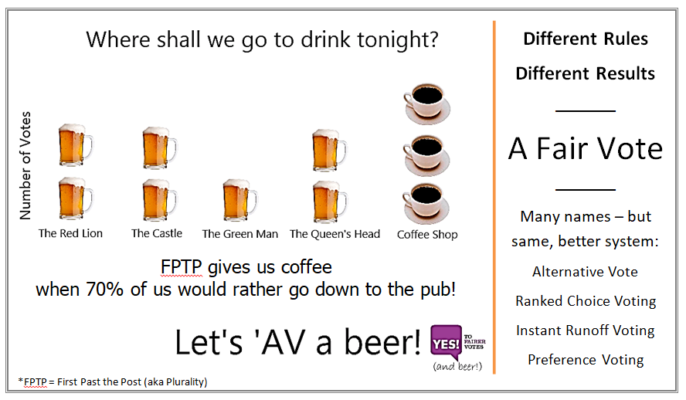

Slide 5
Ranked Choice Voting
(for a single winner)
Power of the Back-Up Vote
(also known as Instant Runoff Voting or IRV)
    Majority winner
    More Expressive of how people feel
    No worry of Spoilers or wasted Votes
    Gives more choices
    Tends toward less-negative campaigns
    Fairer Outcome (electing overall favorite)
Notes:
Show BEER poster
Run Paula’s Assistant election

Slide 6
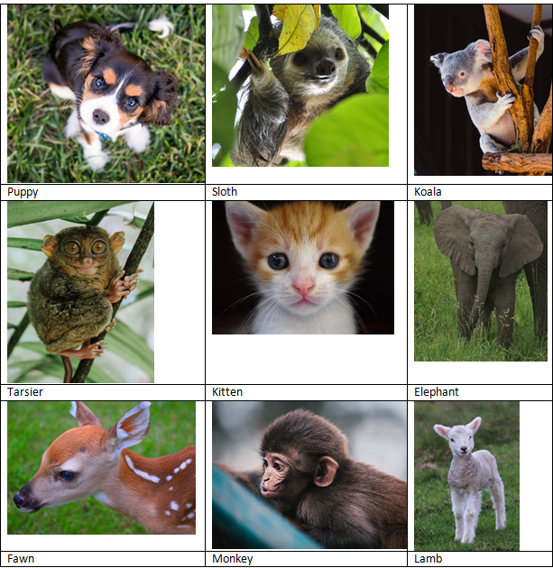
Online Election
At the end – will stay to help people who have a smart phone
Democratic Primary Candidates–ONLINE RCV poll (Sept. results) https://www.fairvote.org/interact_with_the_data
(www.FairVote.org)
Notes:
Underscores in fairvote address

Slide 7
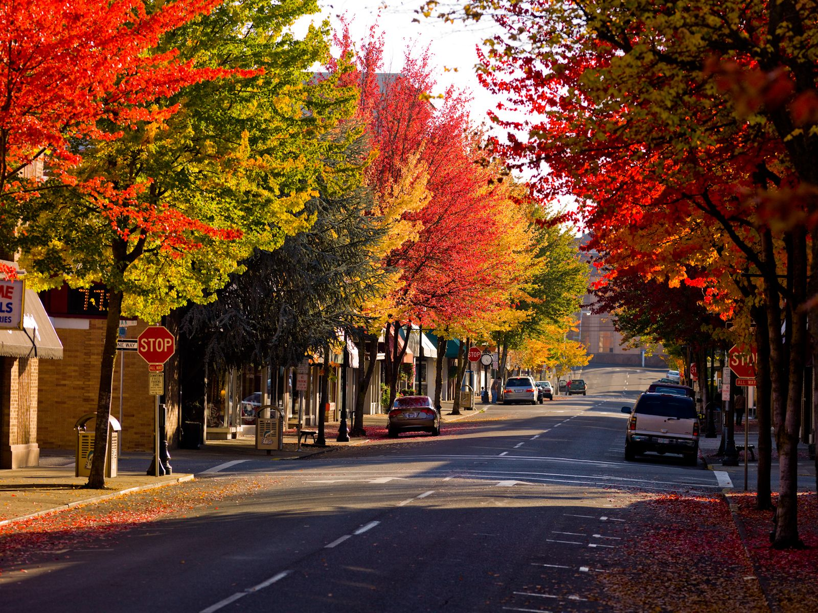
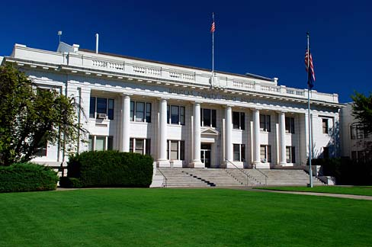
Single and Multiple Winners
Roseburg
Douglas County
8 councilors (SMD)
(2 from each of 4 wards,
4 year term,
staggered elections, 1 seat each 2 years)
Mayor (at large) 2 year term
3 county commissioners, At-large
Notes:
Plurality. [2018? 3 candidates 1 seat – result about 1/3]
Elections, Terms and Wards
Roseburg is divided into four wards, with two Council members per ward. The Mayor, who presides at the Council meetings, is elected at large for a two-year term. Council members serve a four-year term with one Council position in each ward being up for election every two years. The Mayor and Council are non-salaried, volunteer positions, elected by citizens who live within the Roseburg City limits.

Slide 8
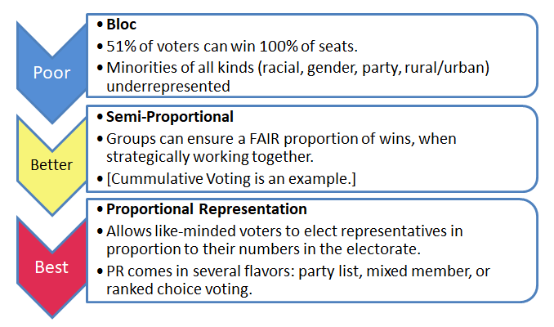
Representing Voting in AT LARGE
(multi winner) Elections

Slide 9
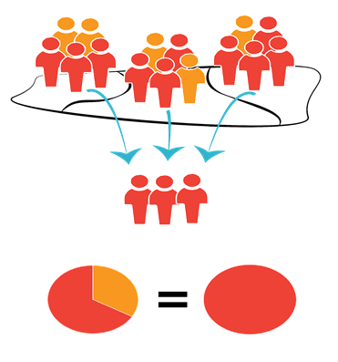
Multiple
Winners
Results with
Winner Takes
All
Voters Voting Voters Represented
Notes:
BLOC type
Jackson county an example. It is why Democrats feel slighted at never having a county commissioner THEY have chosen – because in that county where Republicans are majority, the 51% can elect ALL the winners and the minority party gets none.

Slide 10
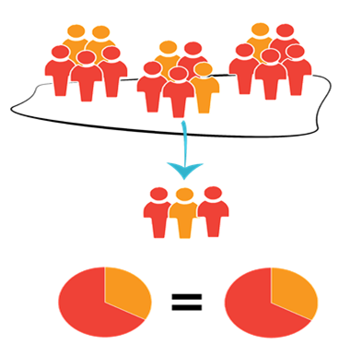
Multiple
Winners
Results with
Proportional Representation
Voters Voting Voters Represented

Slide 11
Scary Math
Deciding ‘Threshold’ or support needed to win ONE seat in RCV Multi Seat Election
Voters do NOT need to know this
Notes:
Same as before…
Only change ONE number

Slide 12
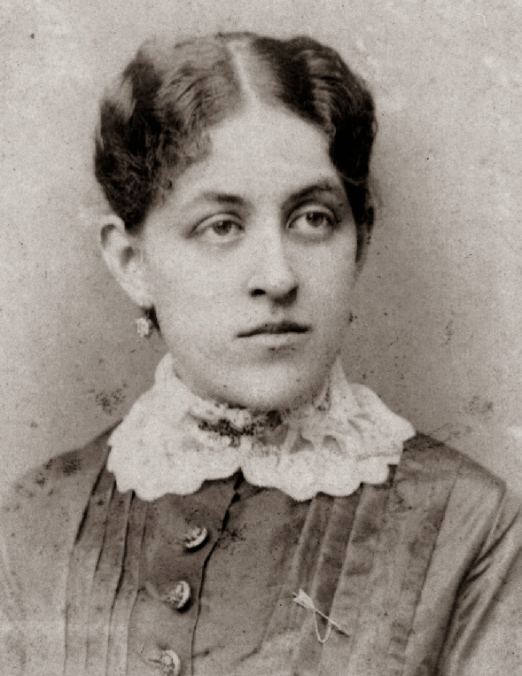
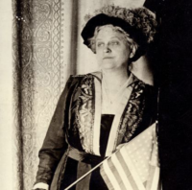
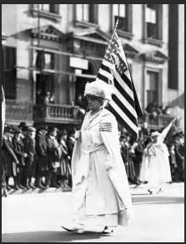
Suffragist & founder of LWV
If you ask any of those women why it is that [their counties] have been willing to elect women, they will say, proportional representation.
They will say that you will never get women in [office] until you get it.
I believe there ought to be women in legislatures and congress. I don't care about the patronage thing. I don't care whether it is in the legislature of the city or the states or the nation, we need women, ………….. so I am for proportional representation.
Quoting Carrie Chapman Catt,
(1921) speaking about European women
Notes:
I have to throw this in since League is celebrating our 100 year birthday this year – couldn’t resist.

Slide 13
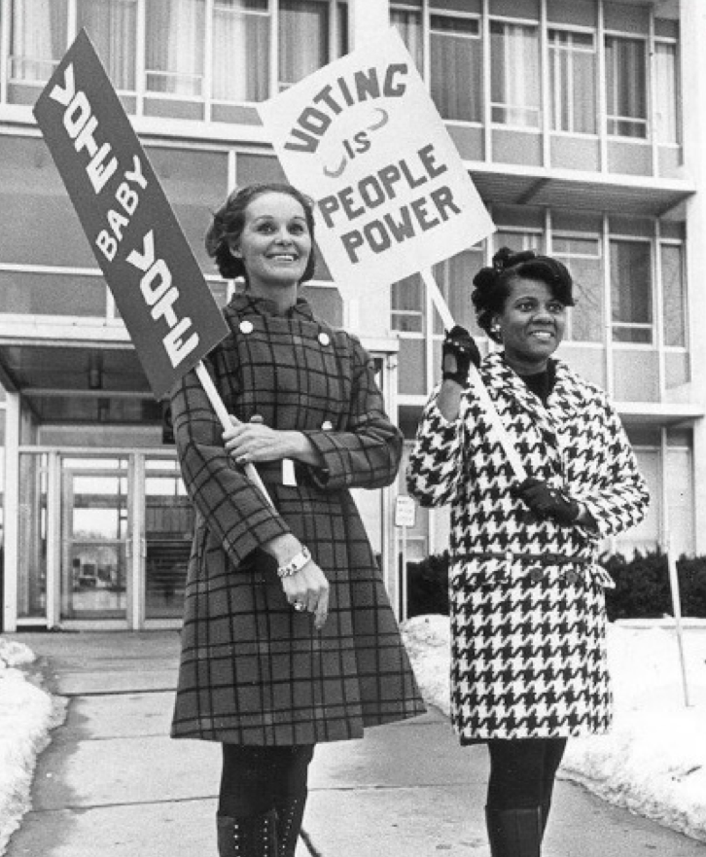
Voting is People Power
June 2019
Eastpointe Michigan
Oregon Voting Rights Act – school boards
Notes:
June 2019 Eastpoint MI – US justice Dept settles Black voting rights lawsuit for sec 2 of VRA by using RCV (at large)
Oregon Voting Rights Act – June 2019

Slide 14
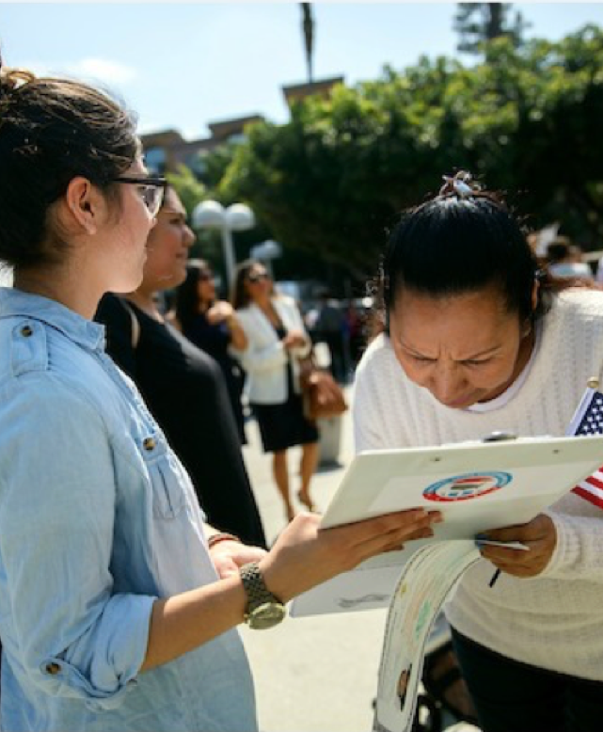
Possibilities for action
Single or Multiple Winners
Local Options Bill (like CA)
?? Not needed in Oregon
Talk to local school board member about Oregon Voting Rights Act
Citizen Efforts – Initiative
Work with Local Officials for Referral to ballot
Text the name “RCV” to 52886 and then click link – to ask Oregon Congressperson to co-sponsor federal RCV Act introduced
Talk to friends, family, clubs, neighbors, organizations to educate them about better ways of voting

Slide 15


“
Q & A
DISCUSSION
RCV for single or multiple winners
"The case for proportional representation is fundamentally the same as that for
representative democracy.
Only if an assembly represents the full diversity of opinion within a nation
can its decisions be regarded as the decisions of the nation itself.
”
-- Encyclopedia Britannica

